Slide 1
TERM PROJECT ANALYSIS OF LUNG CANCER DATASET
Sucharitha Puppala Data Science, Bellevue University DSC530-T301 Data Exploration and Analysis (2227-1) Prof. Shankar Parajulee August 10, 2022

Slide 2
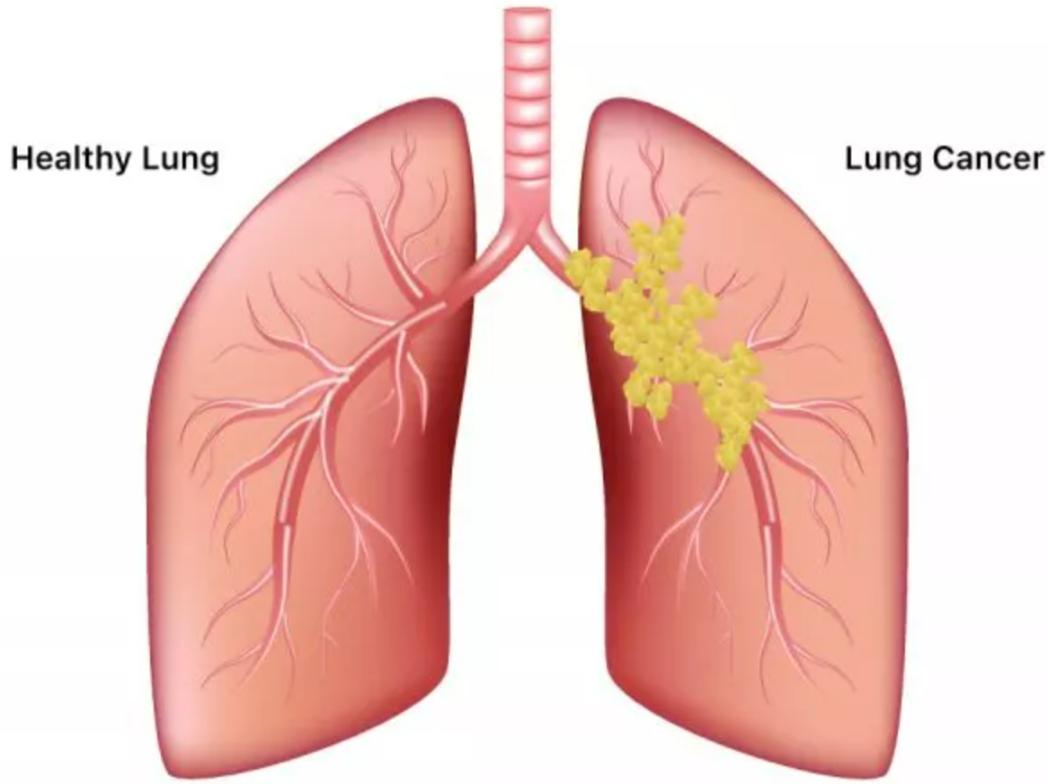
DATA SET
Lung Cancer Dataset is from kaggle.com
The data set is collected from the website online lung cancer prediction system.
With the help of cancer prediction system people will know their cancer risk at a low cost and helps people in taking appropriate decision based on the risk status.
Notes:
Lung cancer is the second most common cancer in women and men, and it’s the leading cause of cancer death, according to the American Cancer Society. The organization estimates there will be about 235,760 new cases of lung cancer in 2021.
Lung cancer begins in the lung and is most common in people who smoke. Common symptoms include chest pain, weight loss, coughing up blood and wheezing.

Slide 3
SELECTING 5 VARIABLES
AGE
SMOKING
CHOUGHING
ALCOHOL CONSUMING
CHEST PAIN
Notes:
The Lung Cancer dataset contain 16 variables
1. Gender: M(male), F(female) 2. Age: Age of the patient 3. Smoking: YES=2 , NO=1. 4. Yellow fingers: YES=2 , NO=1. 5. Anxiety: YES=2 , NO=1. 6. Peer_pressure: YES=2 , NO=1. 7. Chronic Disease: YES=2 , NO=1. 8. Fatigue: YES=2 , NO=1. 9. Allergy: YES=2 , NO=1. 10. Wheezing: YES=2 , NO=1. 11. Alcohol: YES=2 , NO=1. 12. Coughing: YES=2 , NO=1. 13. Shortness of Breath: YES=2 , NO=1. 14. Swallowing Difficulty: YES=2 , NO=1. 15. Chest pain: YES=2 , NO=1. 16. Lung Cancer: YES , NO.

Slide 4
DESCRIBING THE VARIABLES
1.AGE : Patient’s age having Lung Cancer. (type = int64)
People who are 65 or older are at the greatest risk for lung cancer.
2. SMOKING : Smoking causes the majority of Lung Cancers. Here in this dataset we have the data of the patients who has lung cancer and smoke.(type = int64)
3. CHOUGHING : Coughing is one of the symptom for patients who has lung cancer. (type = int64)
4. ALCOHOL CONSUMING : The data set contains the information if the patient having lung cancer has the habit of alcohol consuming or not.(type = int64)
5. CHEST PAIN : This variable gives the information if the patient having lung cancer has chest pain or not. This is one of the symptoms for lung cancer.(type = int64)

Slide 5
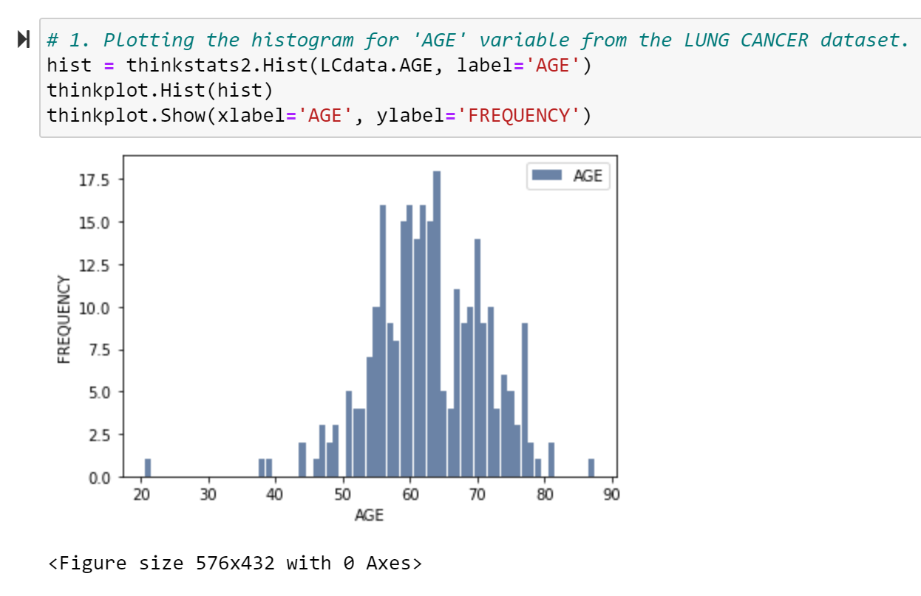
Histogram of variable ‘AGE’
Notes:
Identifying the outliers:
Here from the above histogram we can see that patient’s aged below 45 having lung cancer are rare and the patient’s aged above 50 are at greater risk of having lung cancer are more.
I would like to ignore the patient’s aged 45 below in my analysis.

Slide 6
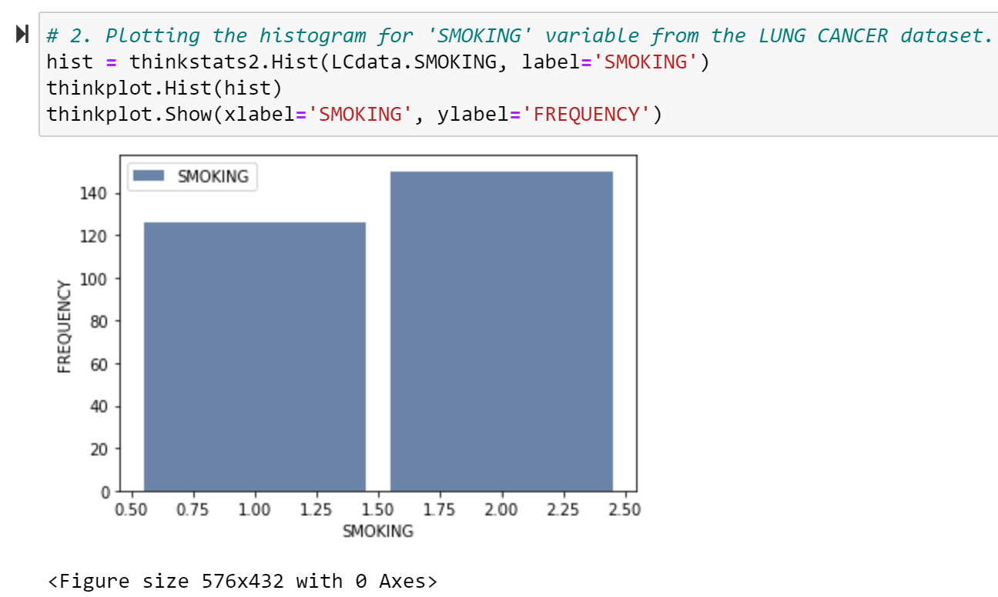
Histogram of variable ‘SMOKING’

Slide 7
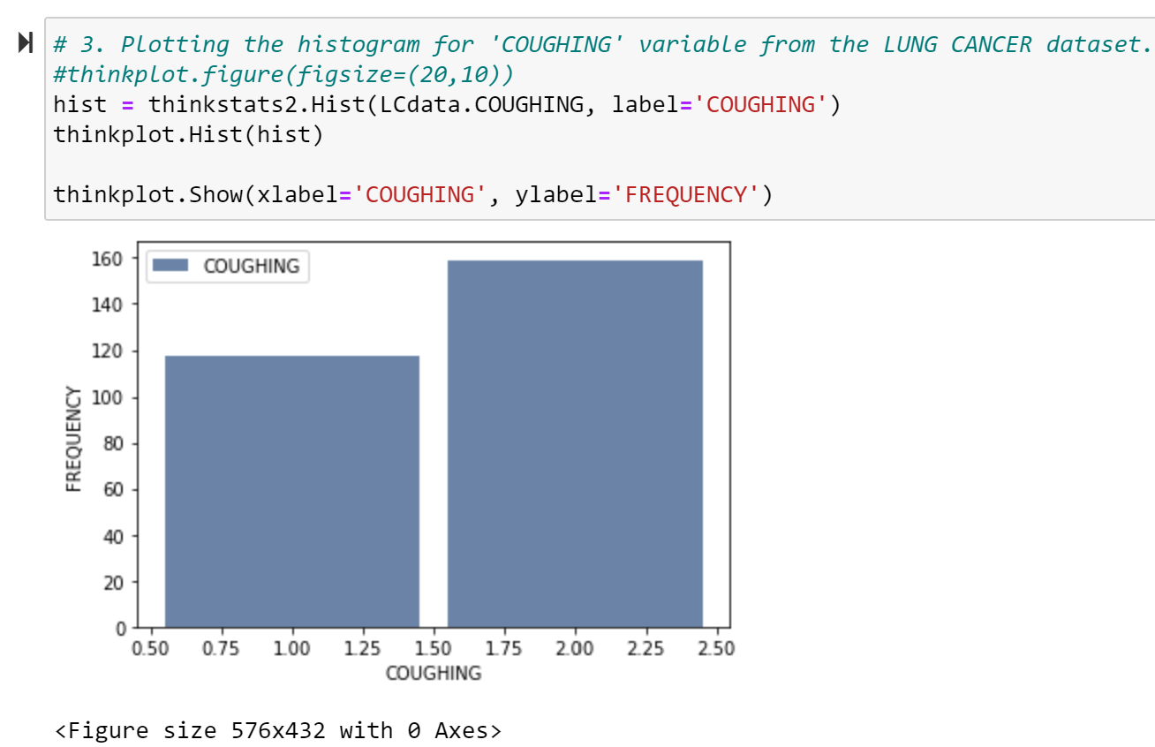
Histogram of variable ‘COUGHING’

Slide 8
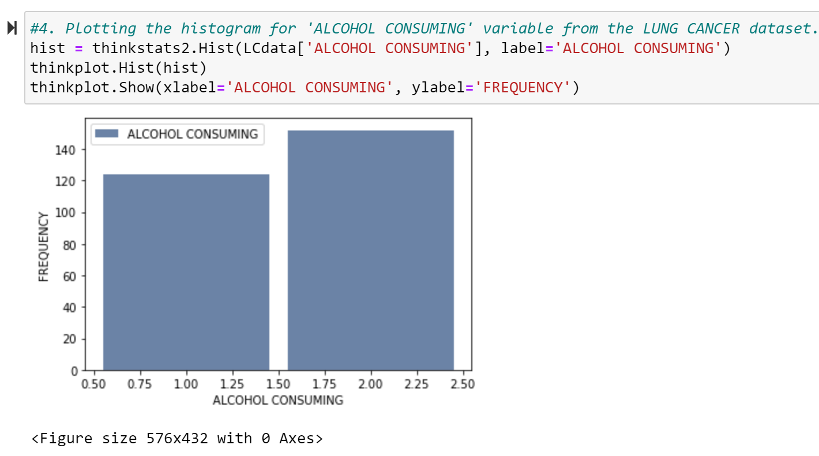
Histogram of variable ‘ALCOHOL CONSUMING’

Slide 9
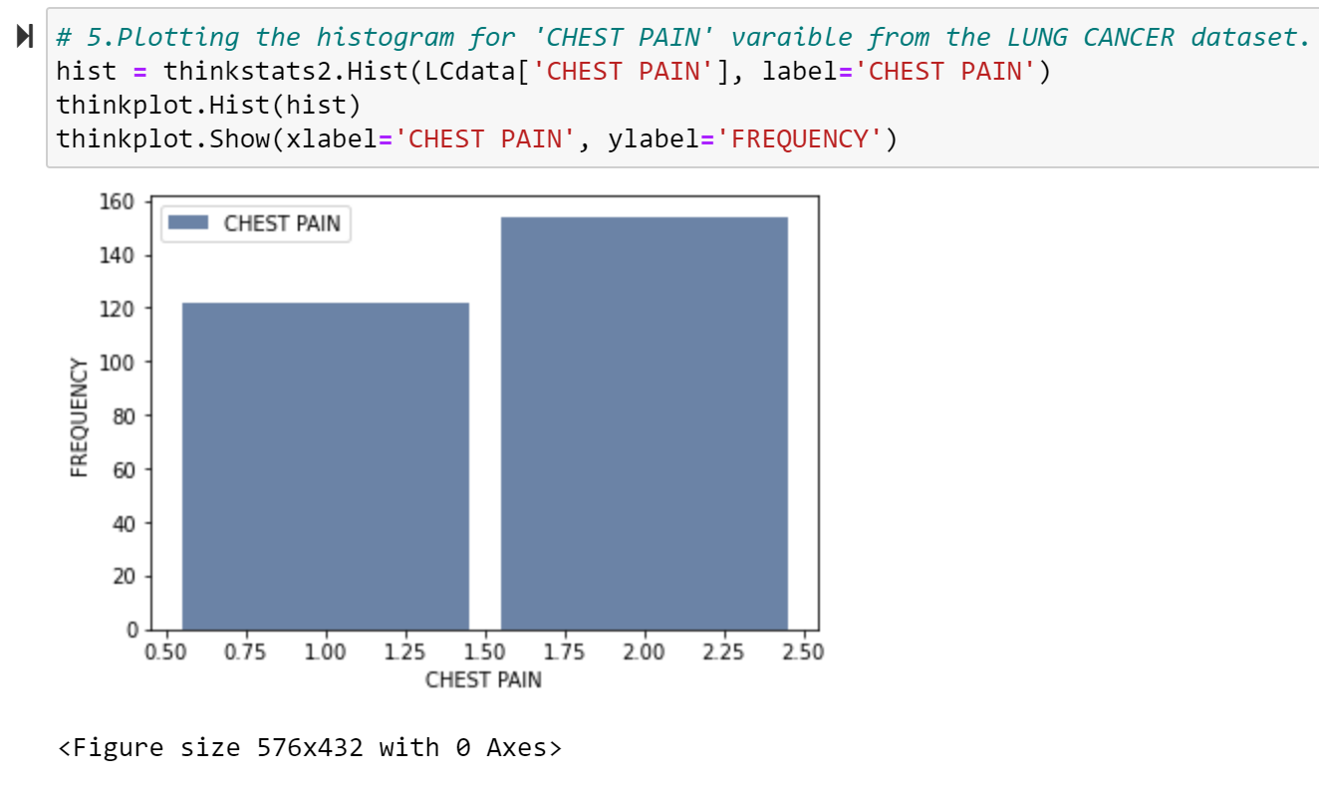
Histogram of variable ‘CHEST PAIN’

Slide 10
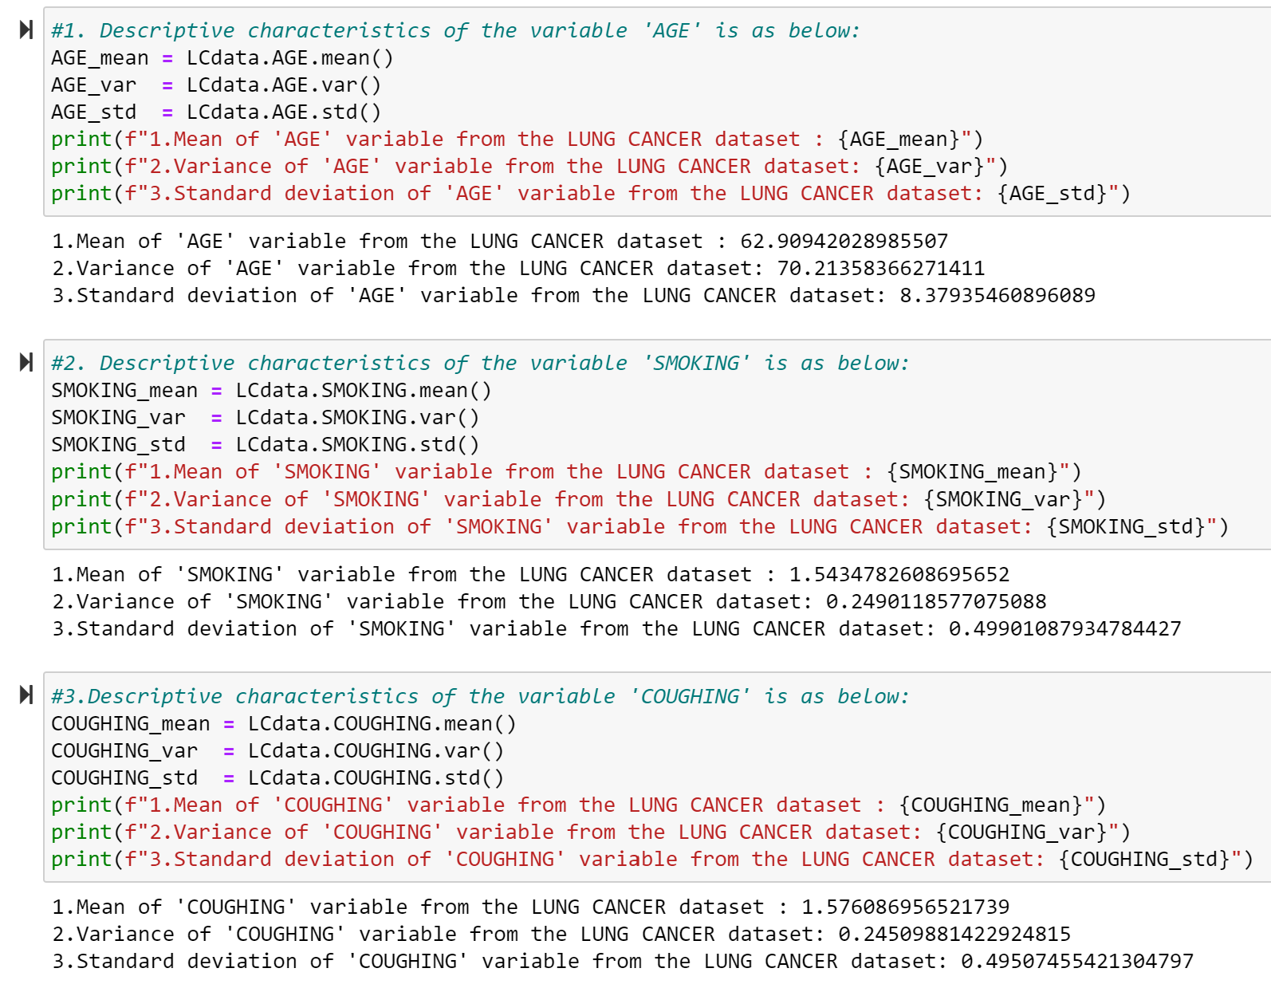
Descriptive characteristics about the variables
- continued

Slide 11
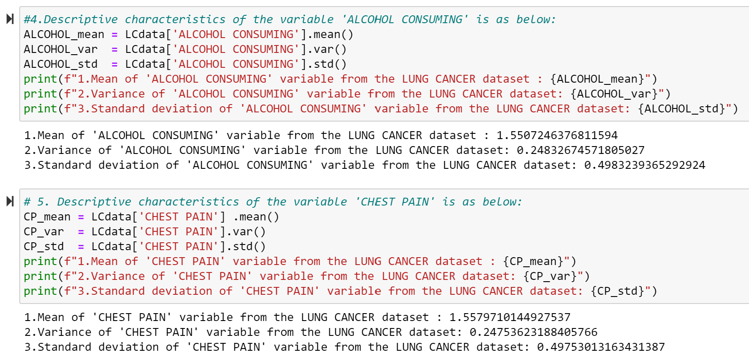
Descriptive characteristics about the variables

Slide 12
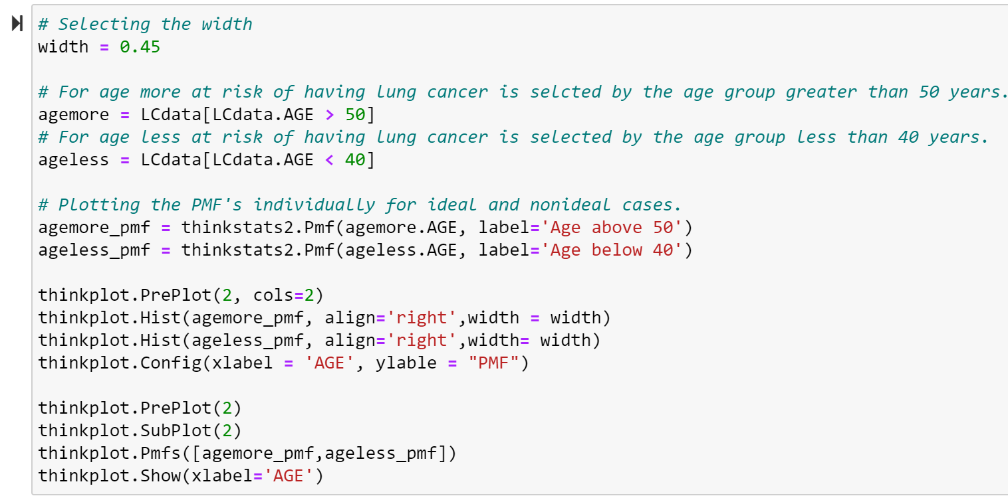
Comparing two scenarios from the data using a PMF.
CODE for PMF plots

Slide 13
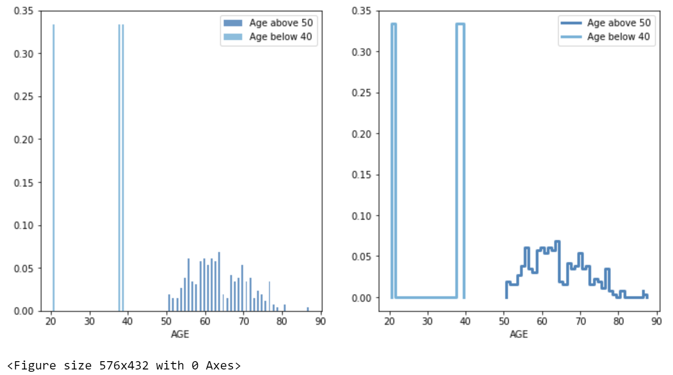
PMF plots

Slide 14
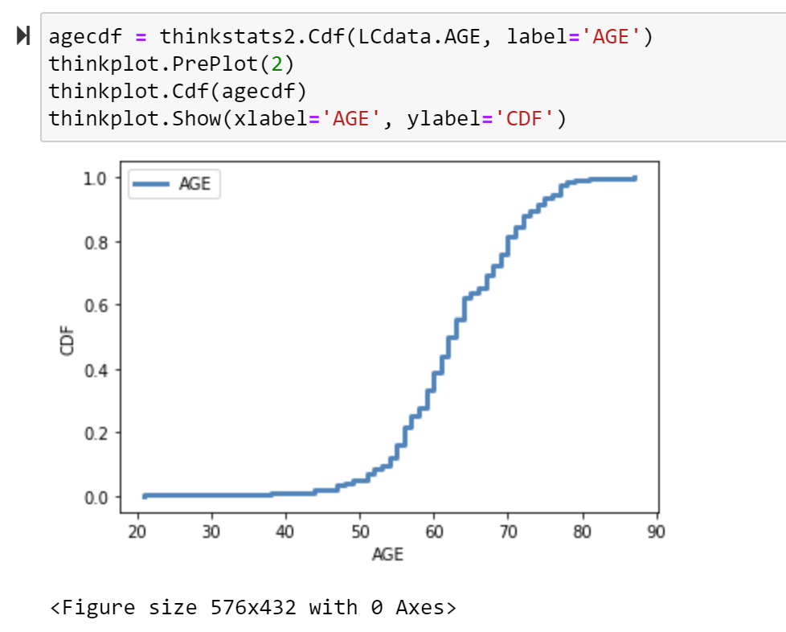
Plotting CDF
Notes:
CDF(Cumulative Distribution Factor):
This is a function that maps from a value to its percentile rank.
Here the above CDF is plotted for AGE variable.
From the above CDF plot the common values appear as steep or vertical sections of the CDF plot.
Here from the above plot the mode at 65 years is apparent.
The CDF range is flat for ages 20 to 40 and 80 to 90.

Slide 15
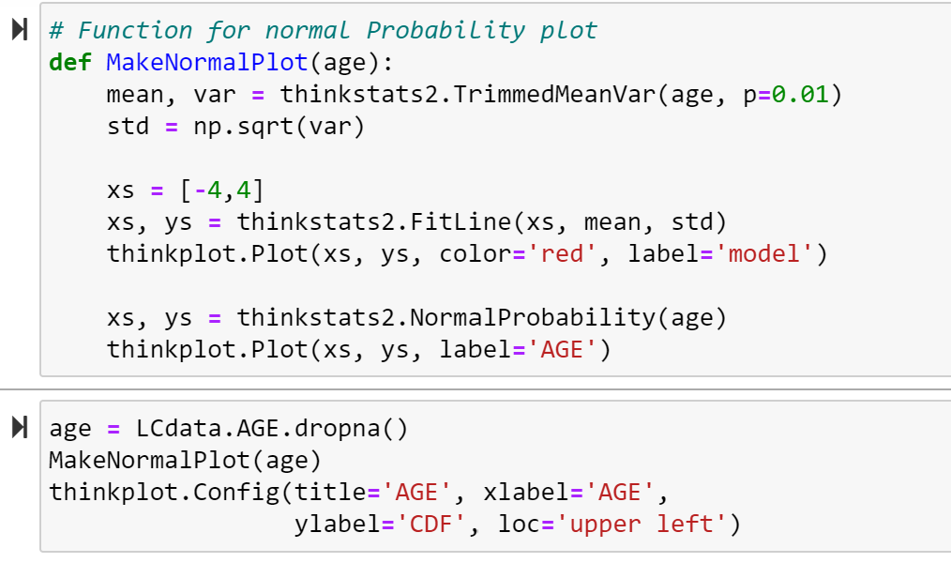
Plotting analytical distribution
Normal Probability Plot
CODE:
- continued

Slide 16
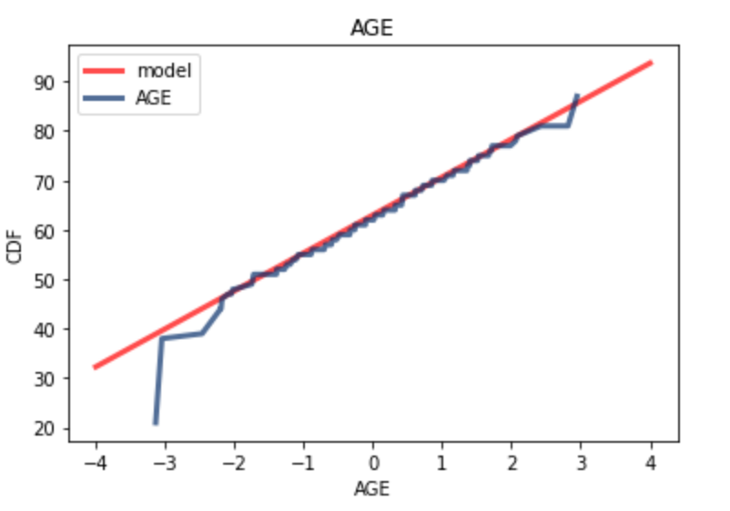
Normal Probability plot of AGE
Notes:
From the above plot we can see that both the curves match the model approximately near the mean and deviate in the tails.
The people aged below are at less risk in getting lung cancer and the people aged above 50 to 75 are at high risk in getting lung cancer.
When we select the maximum possible age group we can remove the people aged below 40 , hence reducing the discrepancy in the lower tail of the distribution.
With above plot we can suggest that the normal model describes the distribution well within a few standard deviations from the mean , but not in the tails.
For practical purposes if this model best fits or not depends on the purpose.

Slide 17
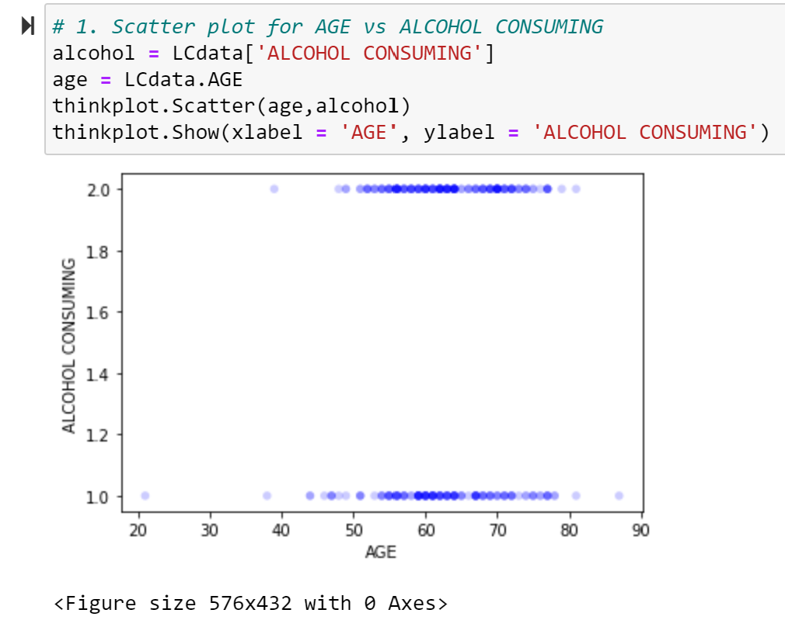
Scatter plots comparing two variables
1.Scatter plot for AGE vs ALCOHOL CONSUMING
Notes:
From the above scatter plot it is clear that there is a linear relation between the variables 'AGE' and 'ALCOHOL CONSUMING'.

Slide 18
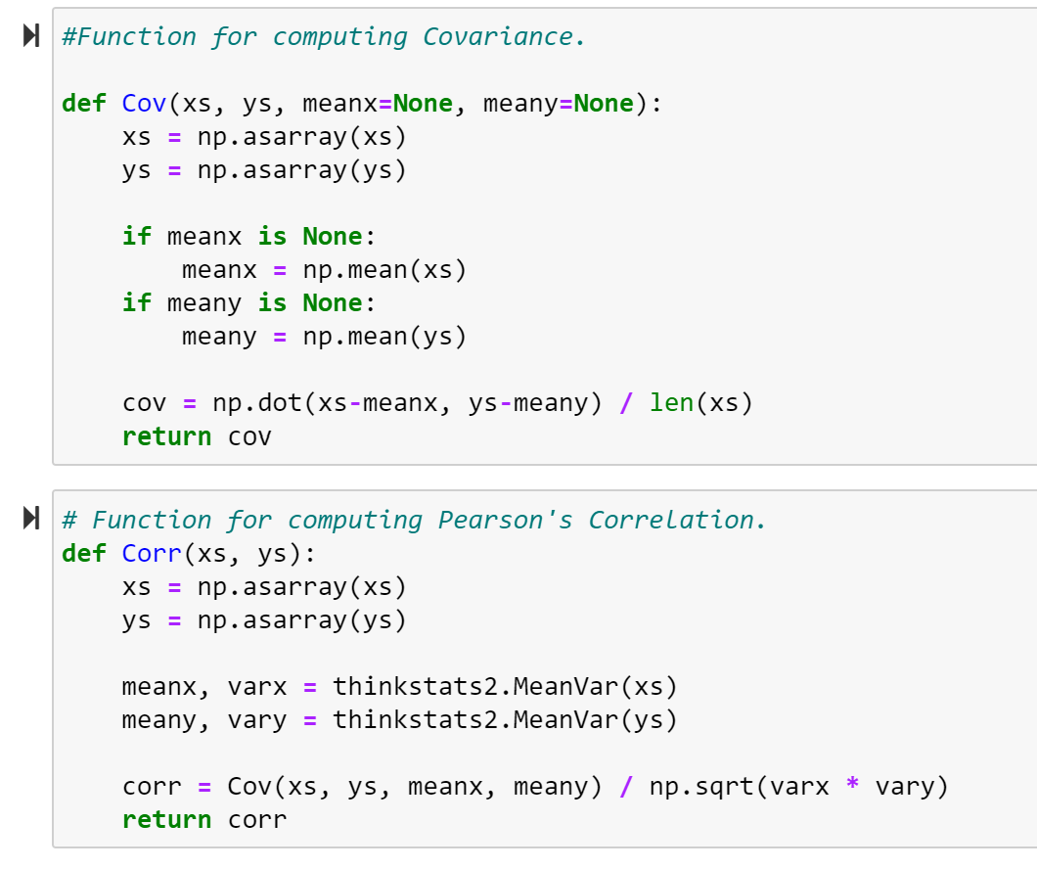
Covariance and Pearson’s Correlation

Slide 19
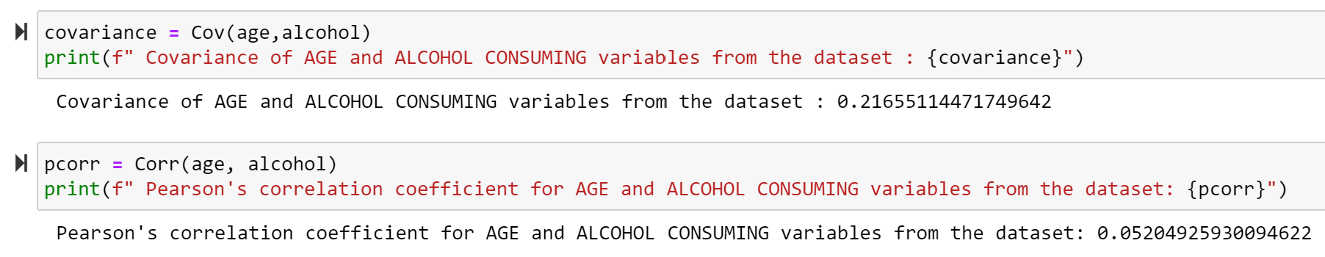
Covariance and Pearson’s Correlation for AGE vs ALCOHOL CONSUMING
Notes:
Covariance measures the tendency of the two variables to vary together.
Covariance is maximized if the two vectors are identical, 0 if they are orthogonal, and negative if they point in opposite directions.
Solution : From the above result we see that the two variables AGE and ALCOHOL CONSUMING are identical, i.e. age group 50 to 80 consume alcohol.
Pearson’s Correlation is always between -1 and +1(including both).
1. If Pearson’s Correlation is positive , we say that the correlation is positive, i.e. when one variable is high , the other tends to be high.
2. If Pearson’s Correlation is negative, we say that the correlation is positive , i.e. when one variable is high , the other is low.
Solution : From the above result it is clear that the correlation between the AGE and ALCOHOL CONSUMING variables is positive.

Slide 20
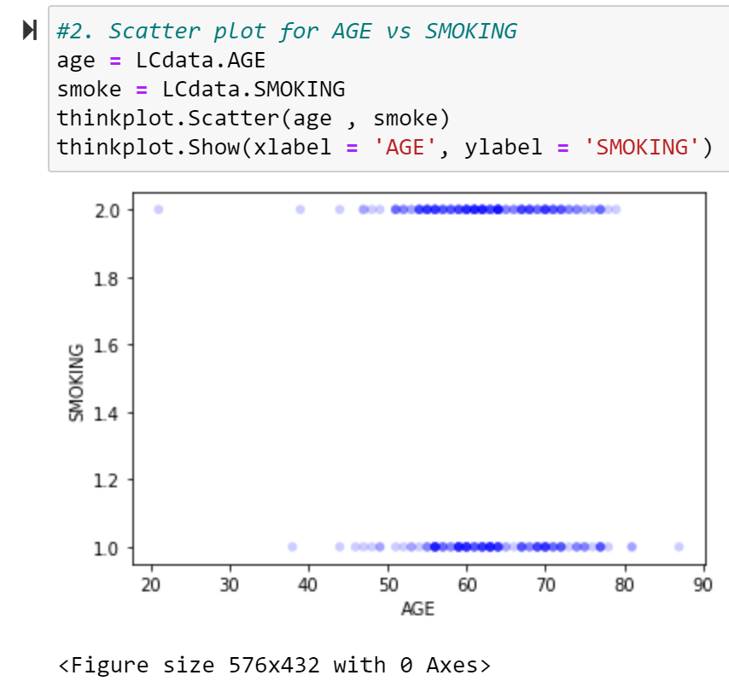
Scatter plots comparing two variables
2.Scatter plot for AGE vs SMOKING
Notes:
From the above scatter plot it is clear that there is a linear relation between the variables 'AGE' and ‘SMOKING'.

Slide 21
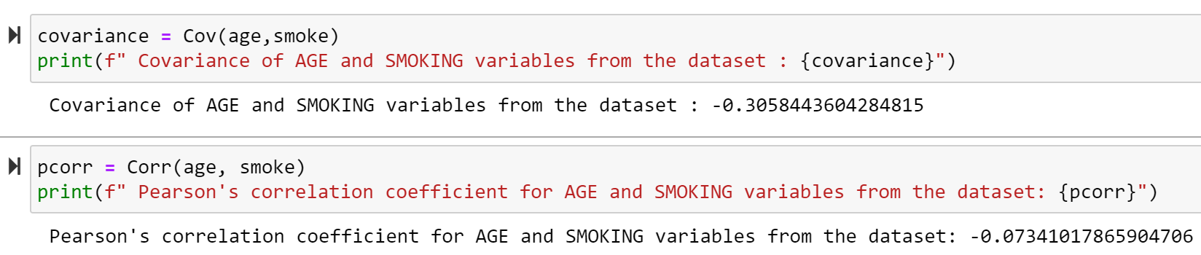
Covariance and Pearson’s Correlation for AGE vs SMOKING
Notes:
1. Covariance measures the tendency of the two variables to vary together.
2. Covariance is maximized if the two vectors are identical, 0 if they are orthogonal, and negative if they point in opposite directions.
3. Solution : From the above result we see that the covariance of the two variables 'AGE' and 'SMOKING' is negative , i.e.they point in opposite direction,i.e age groups 20 SMOKE and may not have LUNG CANCER and the age groups above 90 may not smoke but have LUNG CANCER .
4. Pearson’s Correlation is always between -1 and +1(including both).
If Pearson’s Correlation is positive , we say that the correlation is positive, i.e. when one variable is high , the other tends to be high.
b. If Pearson’s Correlation is negative, we say that the correlation is negative , i.e. when one variable is high , the other is low.
5. Solution : From the above result it is clear that the correlation between the 'AGE' and 'SMOKING' variables is positive.

Slide 22
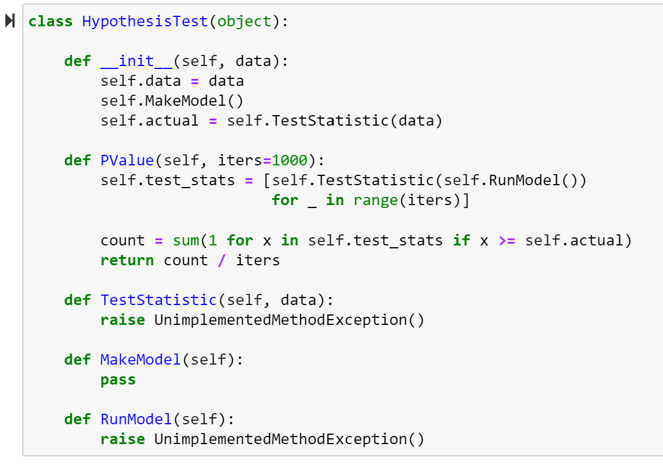
HYPOTHESIS TEST
CODE
- continued

Slide 23
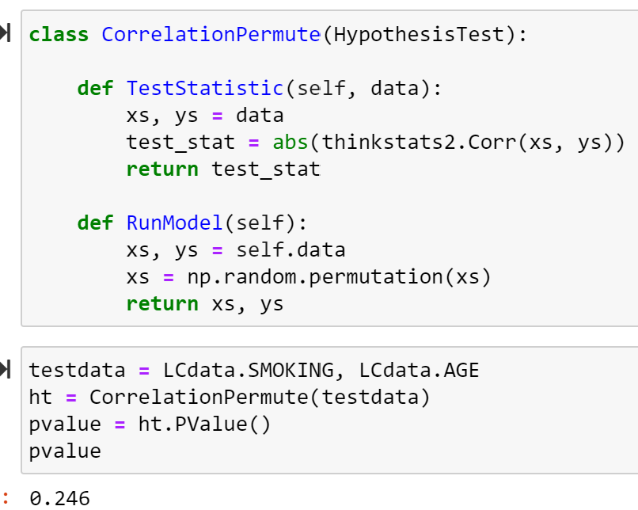
HYPOTHESIS TEST

Slide 24
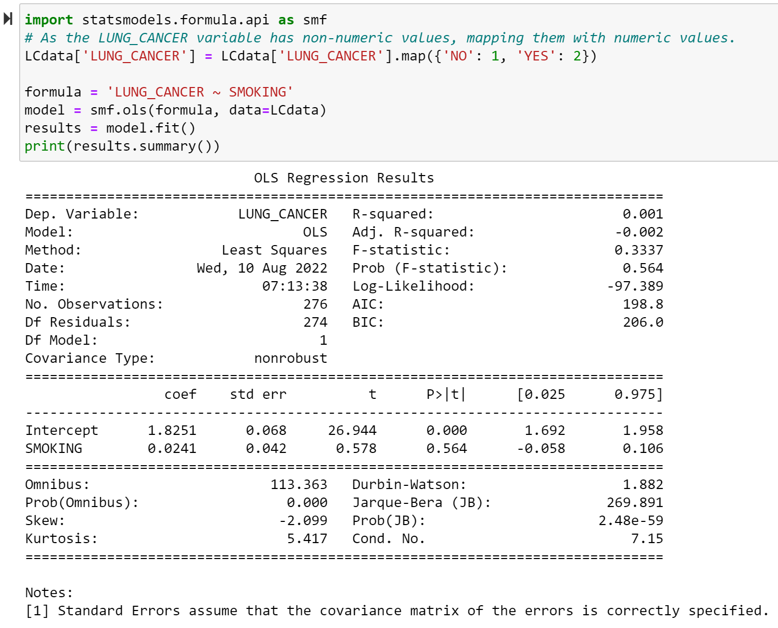
REGRESSION ANALYSIS
Notes:
The above is the regression analysis result of the variables LUNG_CANCER and SMOKING

Slide 25
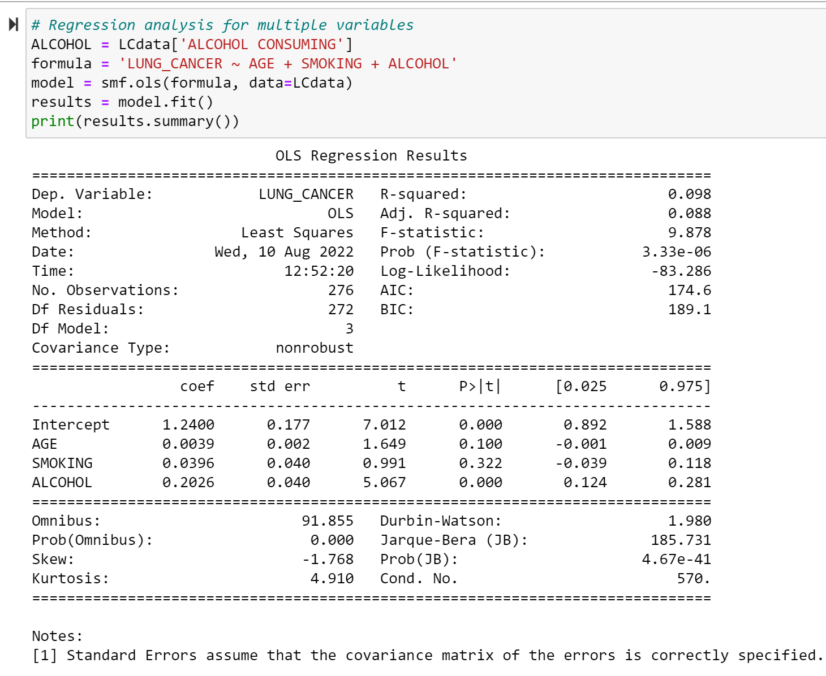
MULTIPLE REGRESSION ALANYSIS
Notes:
The above is the regression analysis result of the variables LUNG_CANCER , AGE, SMOKING and ALCOHOL.

Slide 26
CONCLUSION
Lung cancer is the second most common cancer in women and men, and it’s the leading cause of cancer death, according to the American Cancer Society. The organization estimates there will be about 235,760 new cases of lung cancer in 2021.
People who are 65 or older are at the greatest risk for lung cancer, but in rare cases it may affect people younger than 45.
From the above analysis we can say that the persons who are above 65 years of age and who do smoking are more in number of having the Lung Cancer.

Slide 27
REFERENCES
Google, drugwatch, Lung Cancer
https://www.drugwatch.com/health/cancer/lung-cancer/
Google, kaggle.com, Lung Cancer Dataset
https://www.kaggle.com/datasets/nancyalaswad90/lung-cancer

Slide 28
THANK YOU

